Slide 1
Section-7

Slide 2
Data Flow Diagram (DFD)
DFD Levels
DFD Symbols
Context Diagram
Entity
Level 0
Process
Data Store
Data Flow

Slide 3











Entity Relationship Diagram ……..Data
1
2
3
4
Entity
Relationship
Attributes
(Constraint) Cardinality
1:1………….One –To- One
1:M………….One –To- Many
M:M………….Many–To- Many
Single
- Simple
Strong
Strong
Multi-Values
Weak
Weak
Derived
(Constraint) Modality
Composited
Mandatory
Optional
PK... Primary Key (Unique(

Slide 4
E-Pharmacy
Draw the context diagram and level 0 for the E-pharmacy System
1.In the E-pharmacy System, Each patient fills out an application that includes his personal information.
2.The patient sends the required prescription to the system and the system stores the prescriptions.
3. The pharmacist views the prescription.
4.The pharmacist enters the medicine needed to the system and the medicines should be stored.
5.The patient enters the payment details, and the system stores the payments.
6.The patient receives the medicine and the receipt.

Slide 5
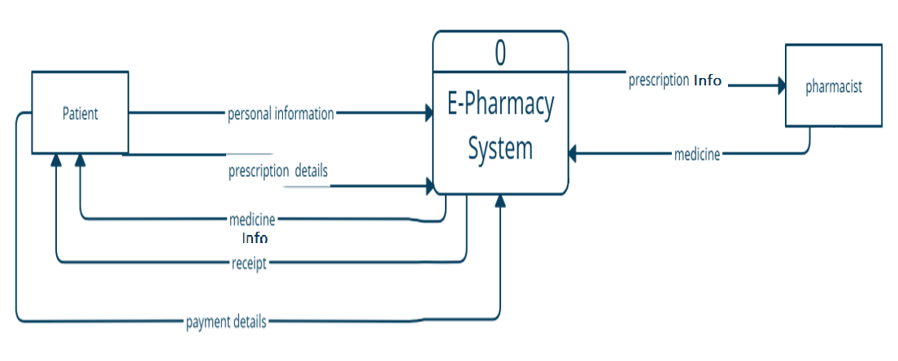
E-Pharmacy- Context Diagram

Slide 6
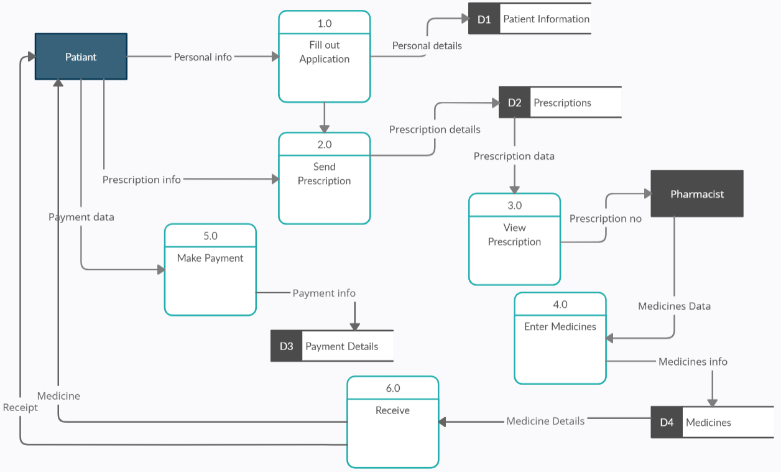
E-Pharmacy- Level 0

Slide 7
E-Pharmacy –Cont.
Draw ERD for the E-pharmacy System
The system should store the patient name and the patient ID , as well the pharmacist name and the pharmacist ID.
Each pharmacist may describe medicine for many Patients.

Slide 8
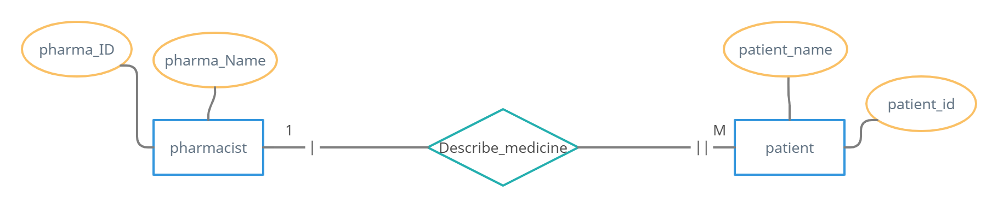
E-Pharmacy- ER Diagram

Slide 9
E-library system
Draw the ERD for the E-Library System
The system store the data about;
Member ( unique id, name, membership date, membership expire-date)
The member may borrow many books.
We keep track of the borrowing date and the returning date for each borrowed book.
The data stored for each book are ( the book id, the authors , price, book name and title).
Also, Each book is published by a publisher , And the publisher can publish many books.
for each publisher we should store the publisher id and the publisher name.

Slide 10
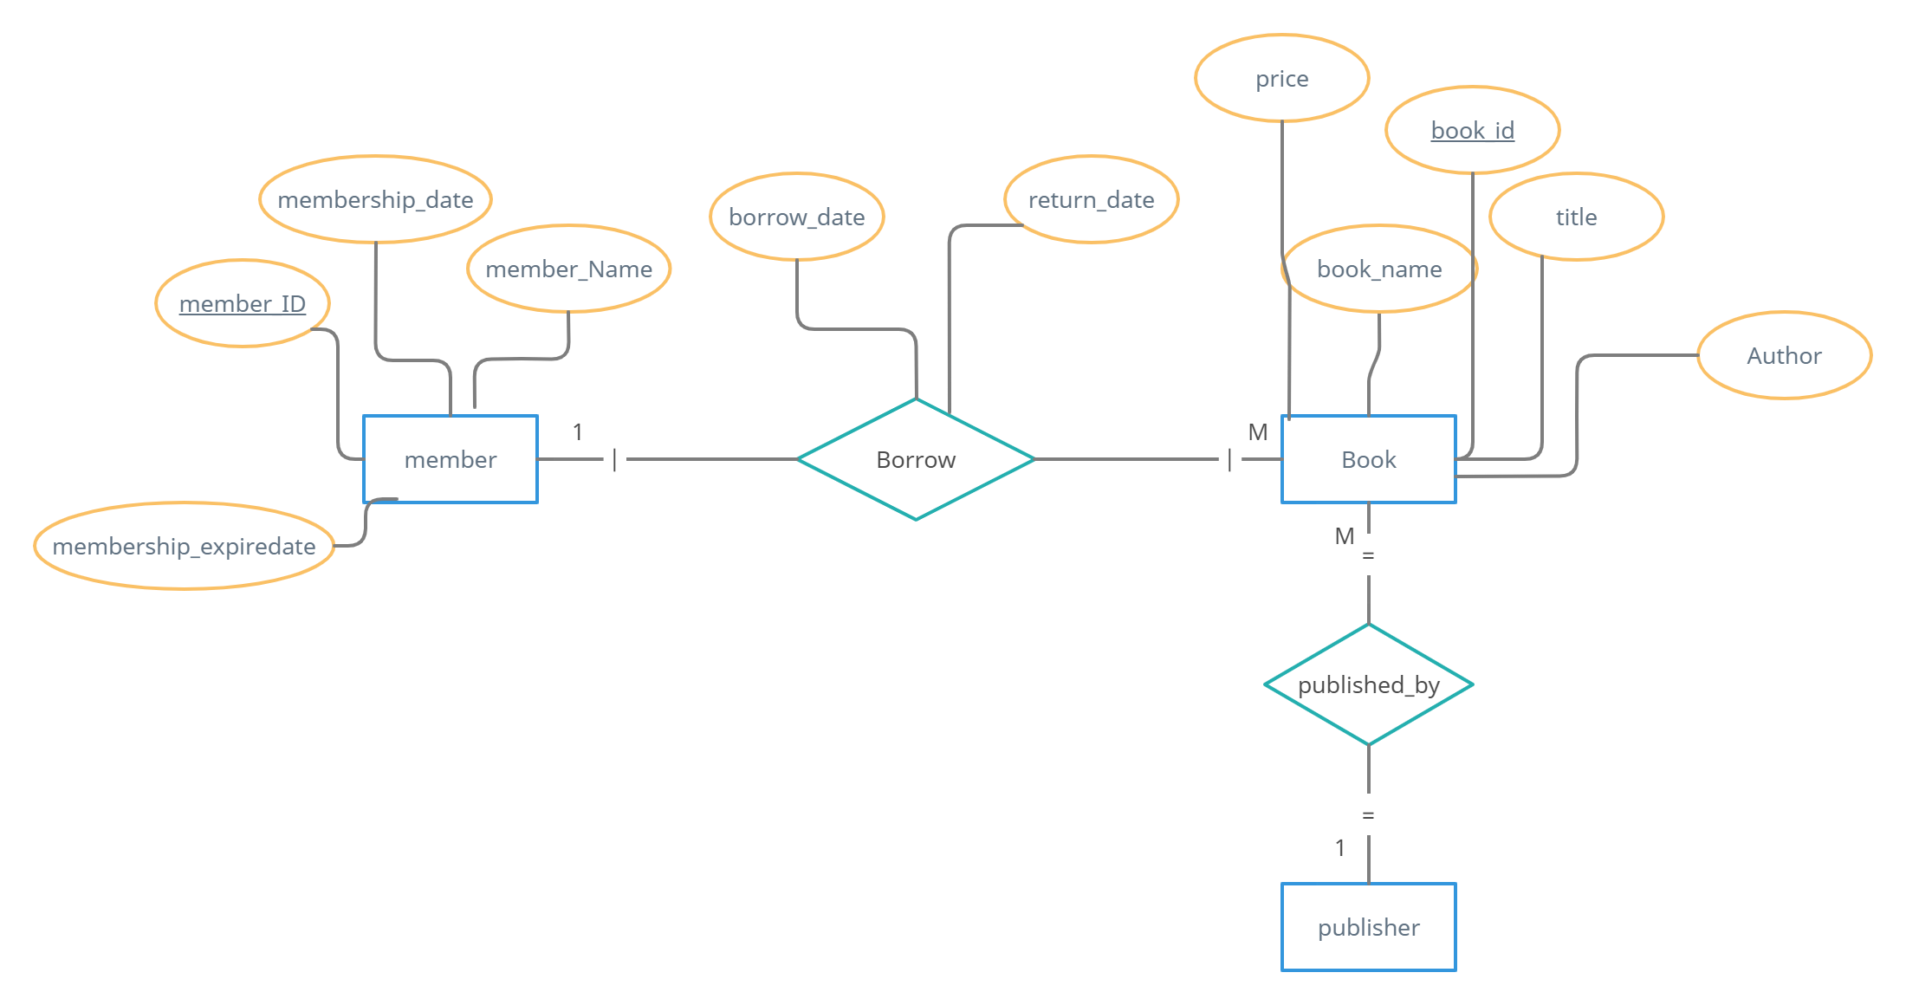
E-library system- ERD
ID
name

